Slide 1







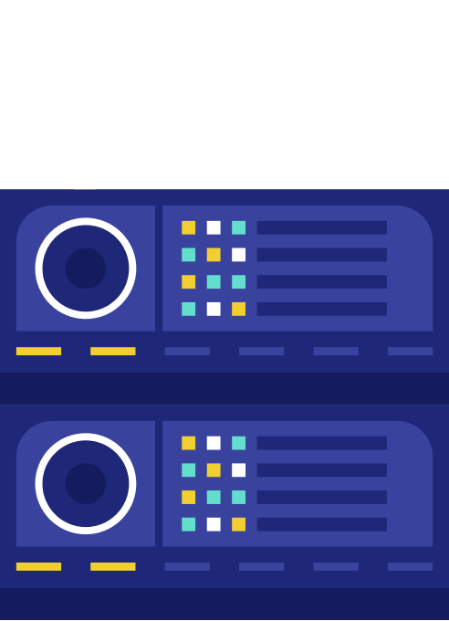






52
Amitesh Patil
54
Kshitij Patil
Client side
56
Pranit Patil
and Serverside
77
Vivek Pundkar
Technologies

Slide 2




Client-Side
Technologies

Slide 3

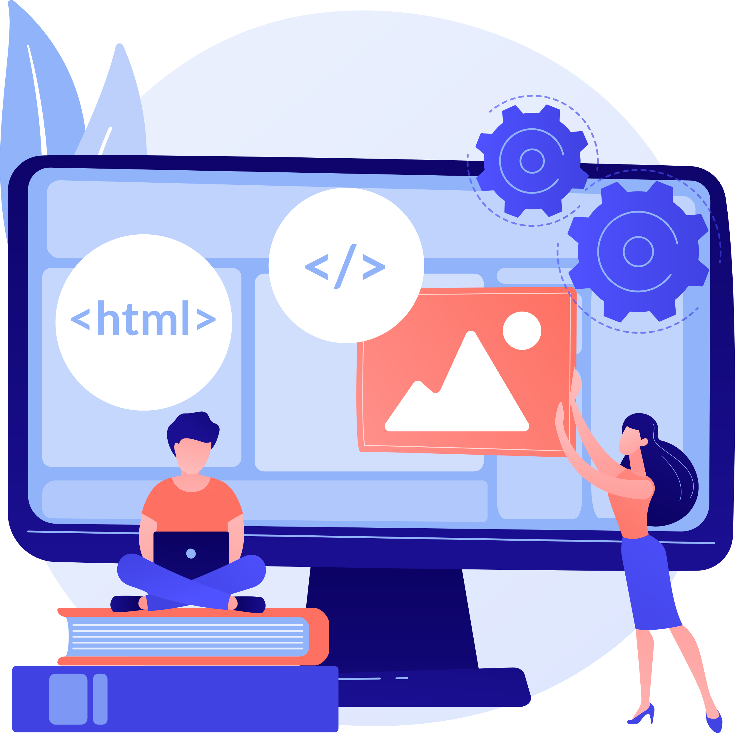
What is Client-side Technology?
It is the program that runs on the client machine and deals with the user interface and any other processing that can happen on client machine like reading/writing cookies.
1)Interact with temporary storage
2) Make interactive web pages
3) Sending request for data to server
4) Work as an interface between server and user
Programming Languages: HTML, CSS, Javascript

Slide 4









Javascript
Lightweight and interpreted programming language.
Enables dynamic interactivity on websites when applied to HTML
Helps users to interact directly without reloading every time
Can be defined as attributes within HTML elements, as blocks of script within a page, or in separate files.
Tasks to be performed with Javascript
1. Selecting an HTML element
2. Querying a Web API for data
3. Performing validation.

Slide 5




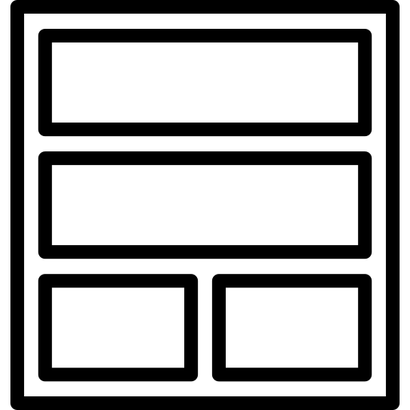


Why do we need Frameworks ?
Tooling
Each framework's ecosystem provides tooling that improves the developer experience.
Abstract the different parts of their user interfaces into components
Compartmentalization
Allows users to navigate from one page to another – it is a network of interlinked documents
Routing

Slide 6





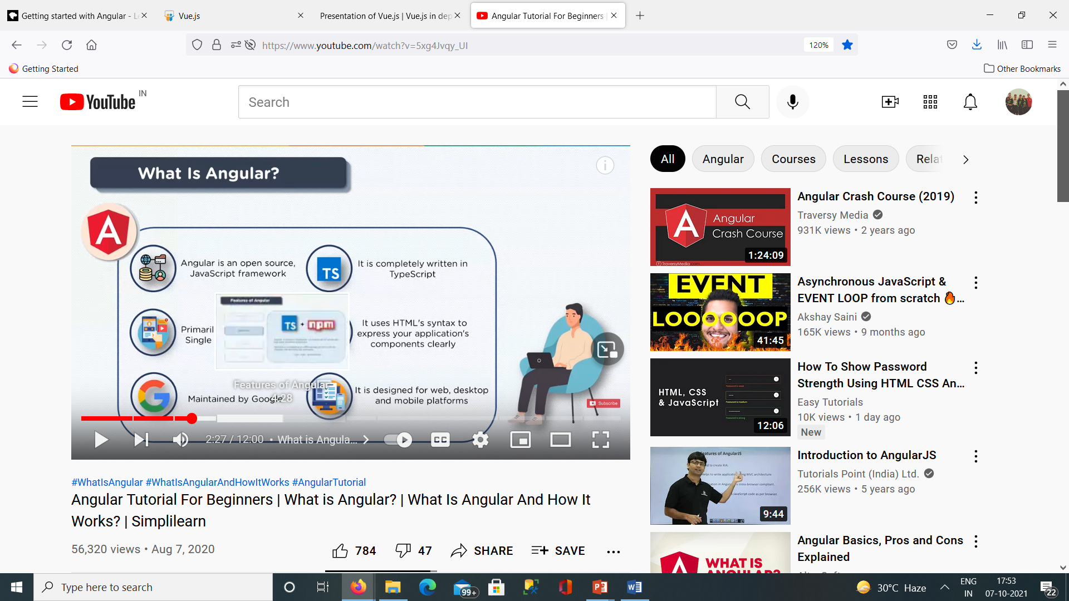
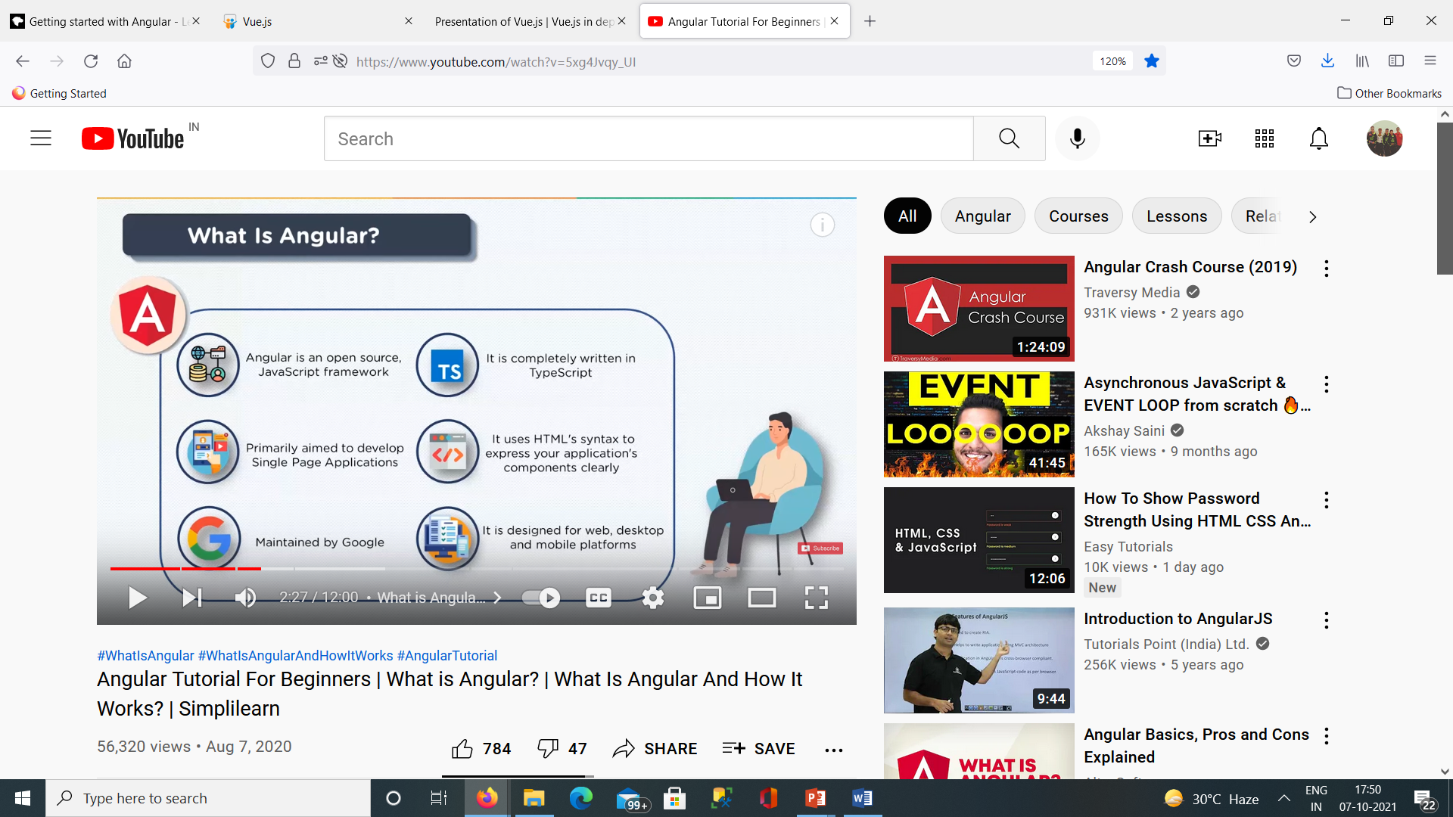
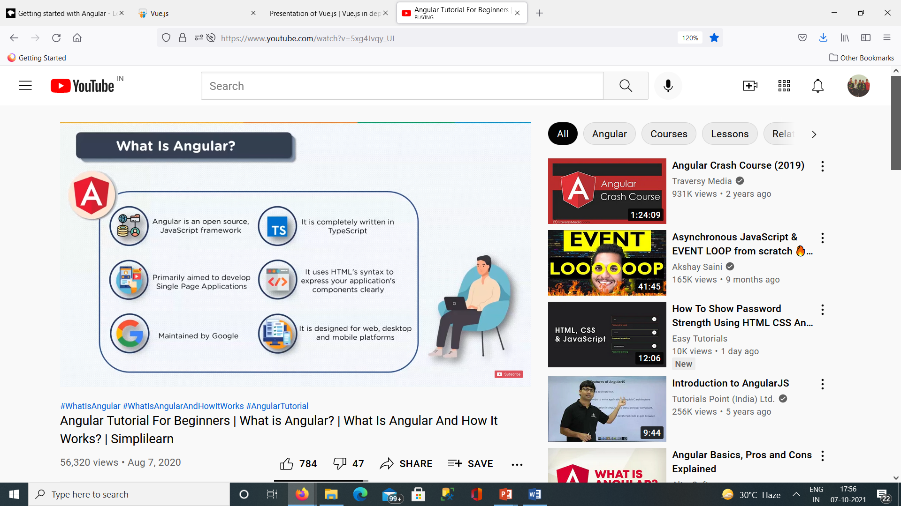
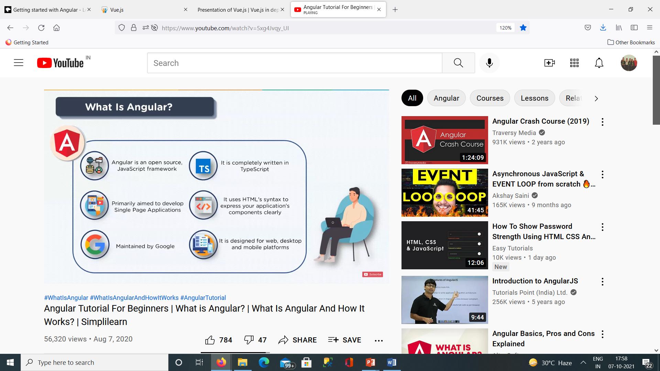
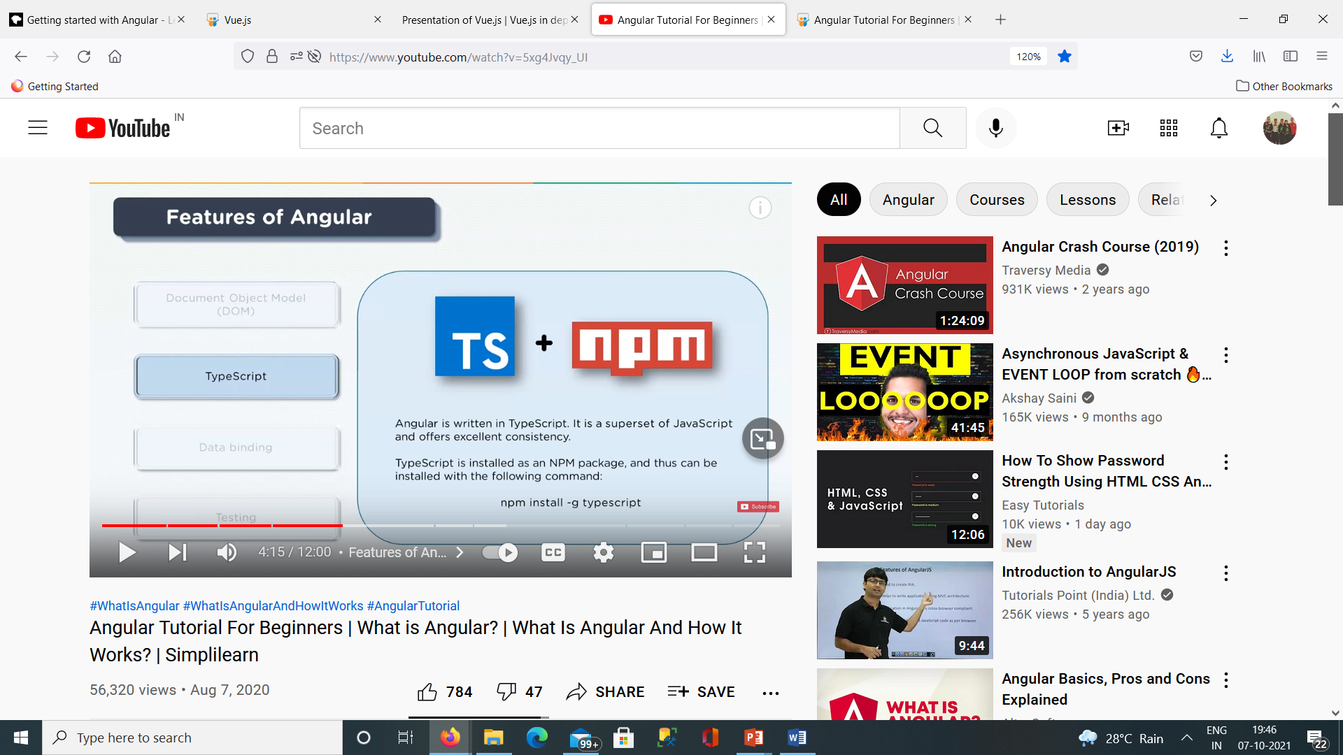
Angular.js
Used to develop SPA’s
Written in Typescript
Maintained by Google
Design Web, desktop, mobile apps
Uses HTML syntax

Slide 7

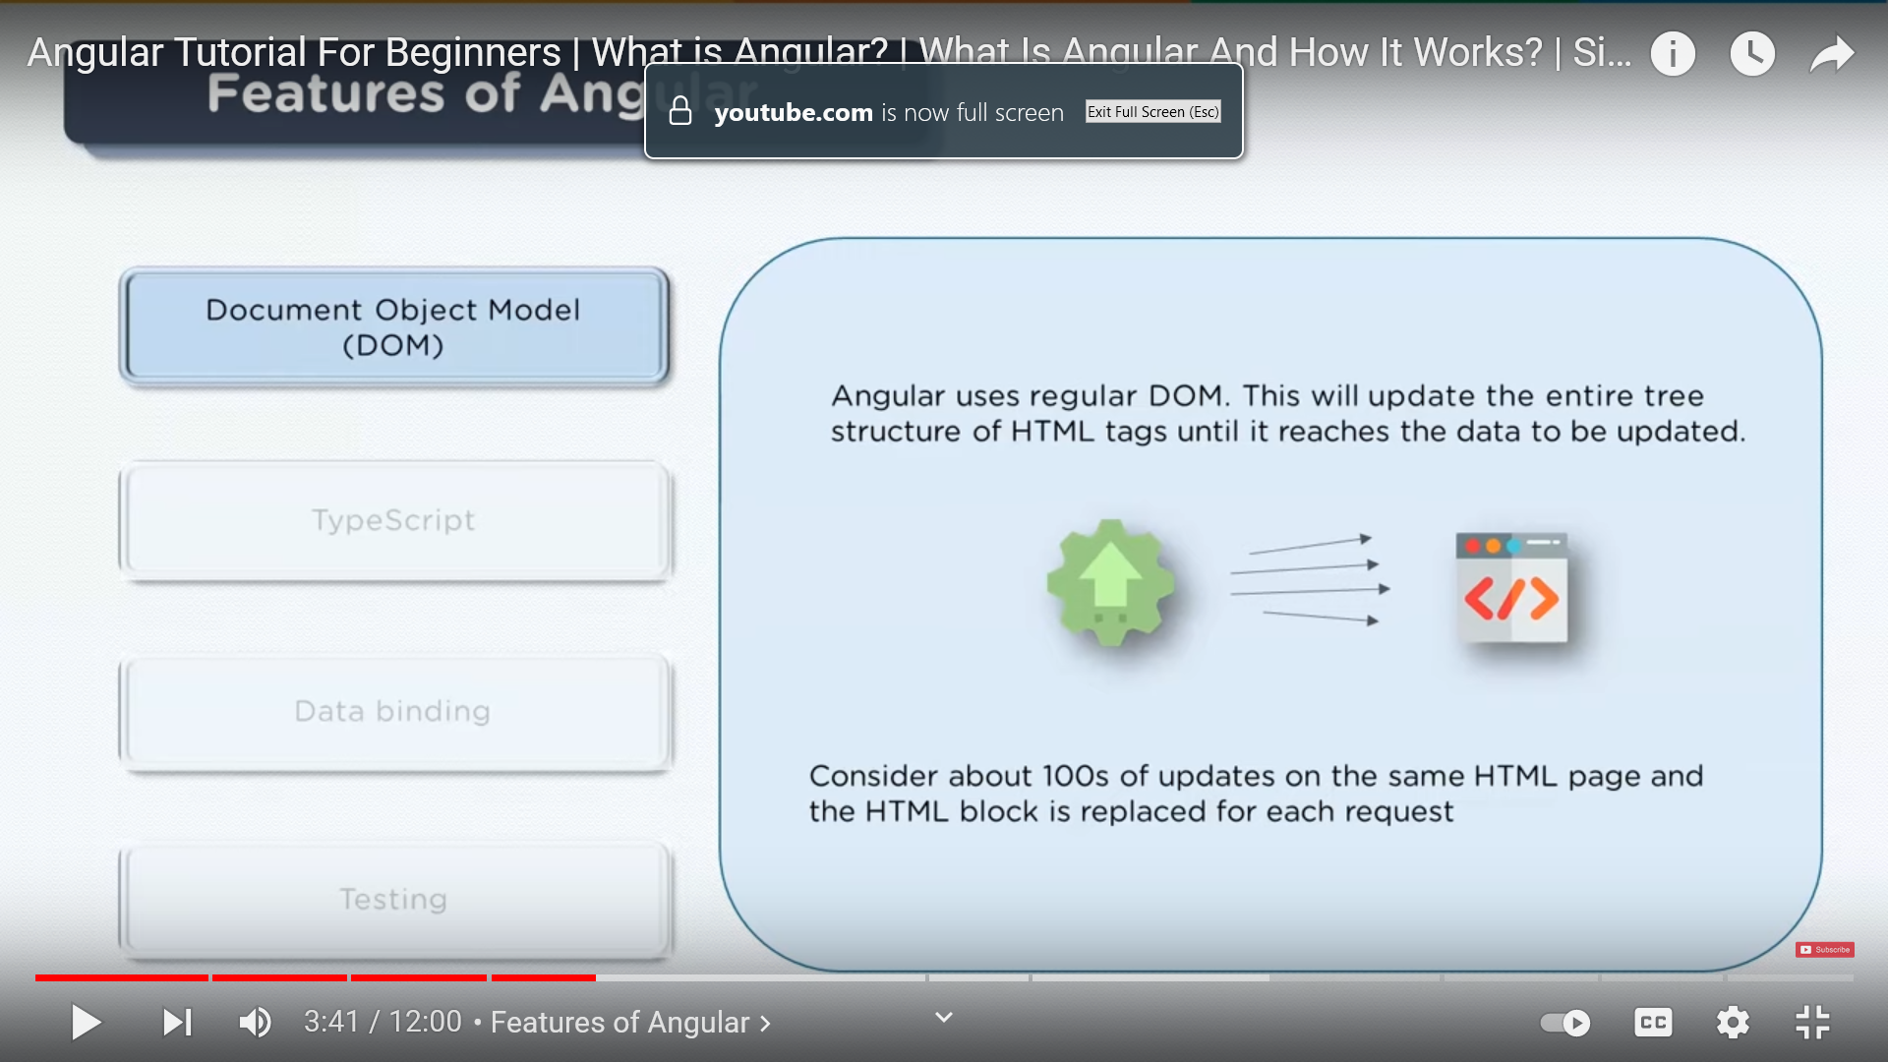
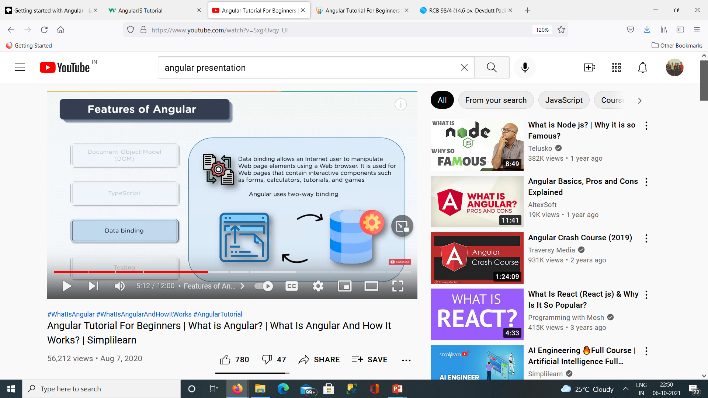
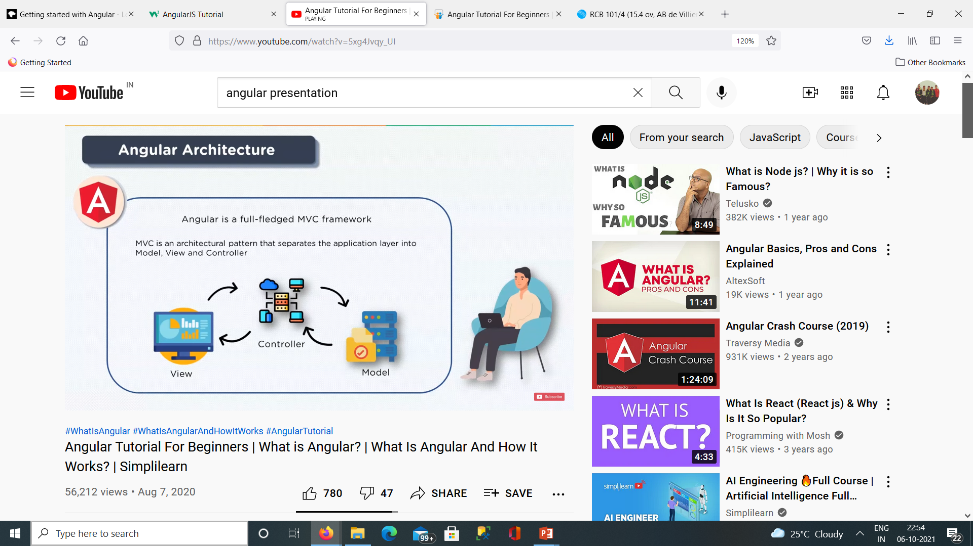
Features of Angular
Document Object Modelling :
Treats an HTML or XML document as a tree structure in which each node is an object representing a part of the document.
2. Data Binding : Data binding allows an Internet user to manipulate Web page elements using a web browser
3. MVC (Model View Architecture)
Model can obtain data dynamically. View contains the visual layout. Controller joins the model and view part

Slide 8
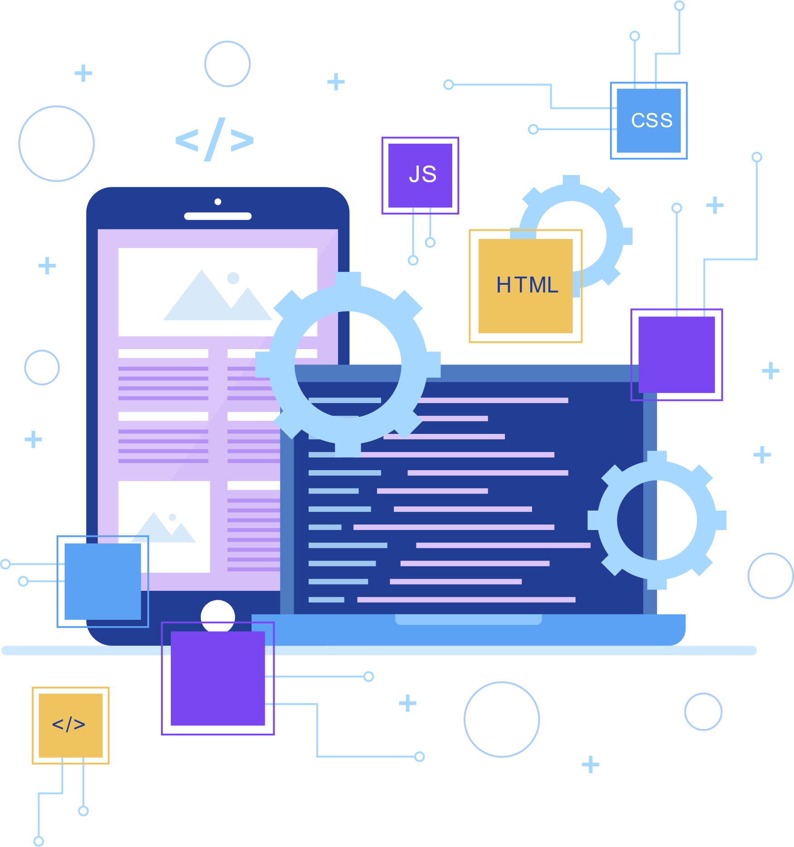

React.js
ReactJs
Beginner Friendly
No react specific things need to learn
Reusable Components
Virtual DOM
Representation of UI is kept in memory and synced with the real DOM
SEO Friendly
One way binding
React components are functional which accepts data through arguments and pass info via return values.
Ex: Facebook, Uber Eats, Airbnb, Instagram, Scype etc.

Slide 9

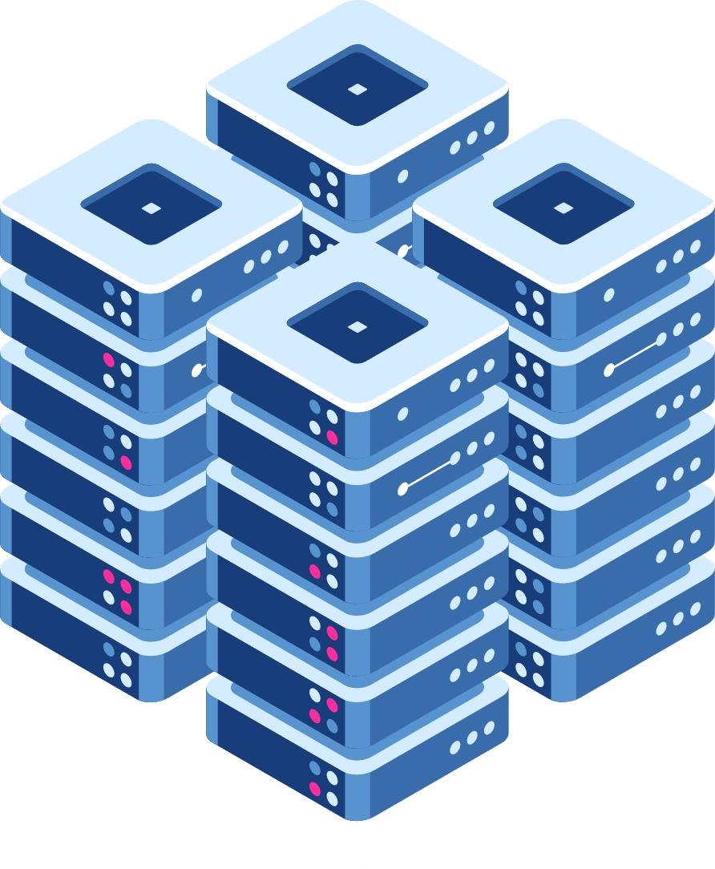

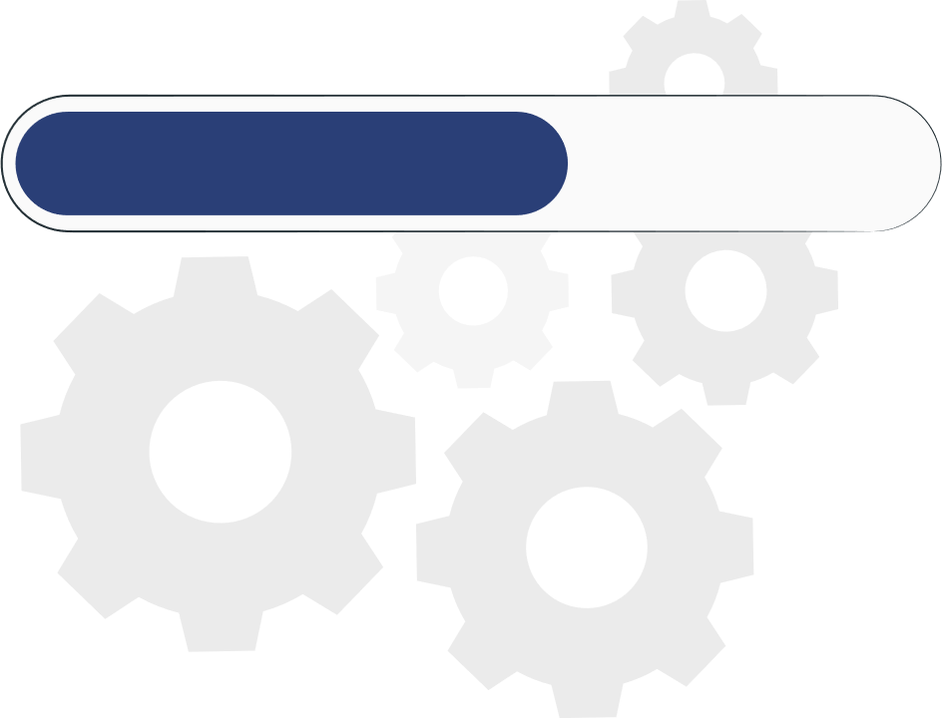
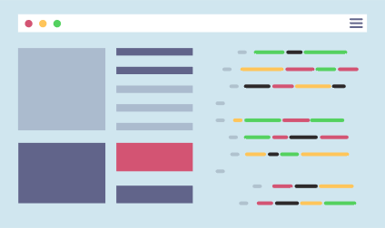
How does react Work?
CDN
Client
Processing
bundle.js
Bundle.js
CDN: Content delivery network
Purpose is to serve file and not much processing.

Slide 10
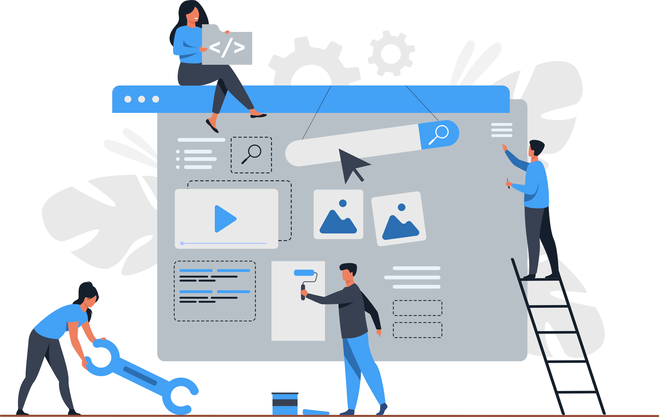
Next.js
NextJs
React framework by Vercel
Automatic Code splitting
Instead of generating one single JavaScript file , app is broken up automatically
Server-side rendering
Typescript support
Ex: Vercel, Netflix, Github, Nike, Hulu etc.

Slide 11
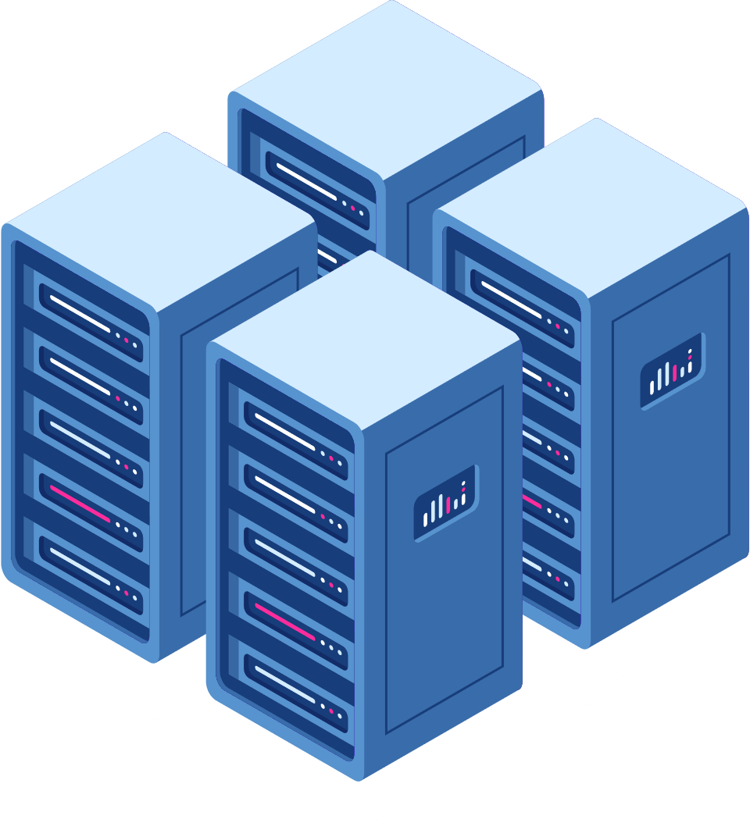
How does next.js Work?
Servers
CDN
Processing Javascript
Client
HTML
HTML
HTML
HTML
HTML

Slide 12


Server-Side
Technologies

Slide 13

Introduction to Server-Side Technologies
Client: a piece of software which operates on the local system and makes HTTP requests to a server.
Client-side technologies can be faster and safer than server-side technologies, however they are limited in functionality and cannot interact with permanent storage such as a database.
If web-application requires permanent storage, server-side technologies are required to complete these processes.

Slide 14
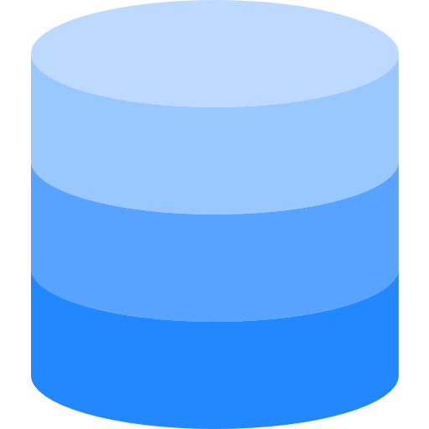

How does it work?
Server-side Scripting language
HTTP Request
Web Pages
DBMS
Query Selector
Operating System running web-browser
Web server with server-side scripting language, query selector and database

Slide 15
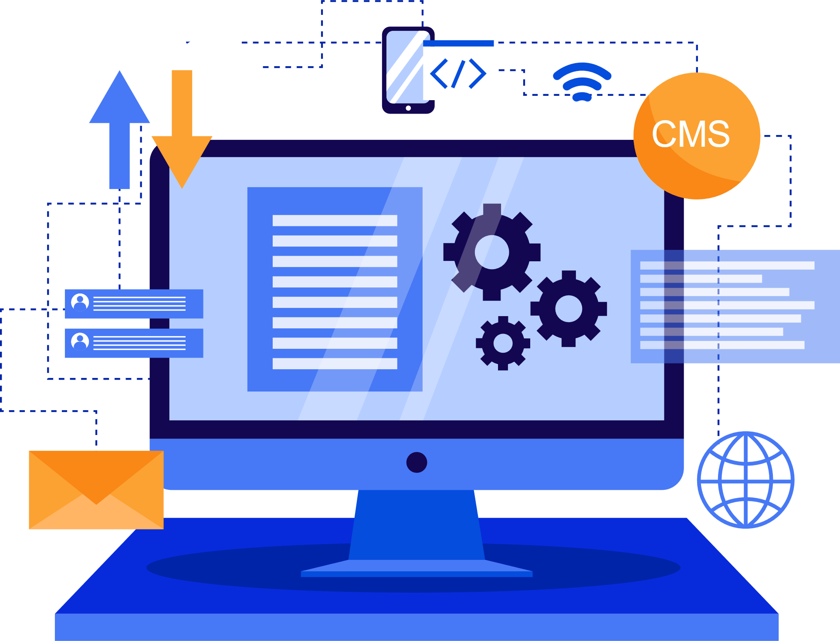

Django
Django
Django is high-level Python web framework that encourages rapid development and clean, pragmatic design.
Ridiculously Fast
Reassuringly Secure
Exceedingly Scalable

Slide 16

How does Django work?
MODELS.PY
Query Sets
VIEWS.PY
Result set
Response
Request
Templates
Index.html
(HTML – JS – CSS)
Read/ Write
Database
www.youtube.com

Slide 17


Node.js
NodeJs
An open-source, cross-platform, back-end JavaScript runtime environment that runs on the V8 engine and executes JavaScript code outside a web browser.
Using HTTP module we can use node js as server-side component.
Very popular among developers and forms MERN and MEAN stack
Express.js, Meteor.js, Nest.js, Hapi.js are popular node.js frameworks

Slide 18

Ruby on Rails
Ruby on Rails is a web application framework
written in Ruby which is a dynamic programming
language.
Emphasize on Convention over Configuration (CoC), and the Don't Repeat Yourself (DRY) principle
Ruby uses Metaprogramming.
Every 20th website on the Internet amongst the top 10,000 best websites uses Ruby on Rails for web development.
Ex: GitHub, codecademy, Airbnb, Basecamp, Shopify, Groupon, etc.

Slide 19

Features of Ruby on Rails
Time-efficiency : offers multiple ready-made modules and plugins
MVC Architecture : one of the most widely used web application architectures globally.
Testing is simple – offers RSpec an easy-to-use unit testing setup
Rapid MVP development : reduces the app development time by almost 25 to 40 percent. Because of the lean codebase, RubyGems, and extensive open-source code.

Slide 20

CakePHP
CakePHP is an open source framework that enables us to create multi-featured and highly specialized websites easily.
Uses convention over configuration approach
Build for rapid application development
Follows MVC architecture
Ex: Mapme, Educationunlimited, FollowmyTv etc.

Slide 21

Features of Ruby on Rails
ORM - ORM or Object Relational Mapping is a data conversion technique used to convert data for an incompatible system.
CRUD functionality - CakePHP offers CRUD functionality that enables users to create, read, update, and delete actions within an application.
Security - core security and CRUD features allow it to be secure in the user submission process in less time.
MVC design – CakePHP depends on Model View Controller

Slide 22

Go Language
Go language was founded in 1995 and is object-oriented, influenced by languages such as C, Perl and Java.
Rich library
Simplicity of Go
Goroutines

Slide 23

React is very popular and fast framework while nextJS makes react even faster and convenient. In server-side scripting Node.js popular but GO is more faster than nodeJS and it was also build to fill the gaps between other languages. So GO is best option to go with.

Slide 24




References
Research Papers
A survey on client side and server-side approaches to secure web applications
Comparison between client-side and server-side rendering in the web development
A client-side web application for interactive environmental simulation modelling
Websites
https://reactjs.org/docs/getting-started.
https://docs.djangoproject.com/en/3.2/
https://www.google.com/search?client=firefox-b-d&q=node+js+official+documentation

Slide 25


Thank You

